Slide 1

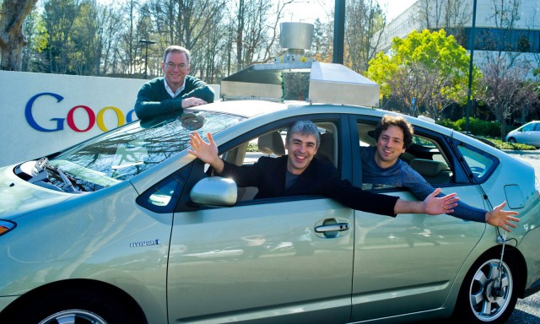
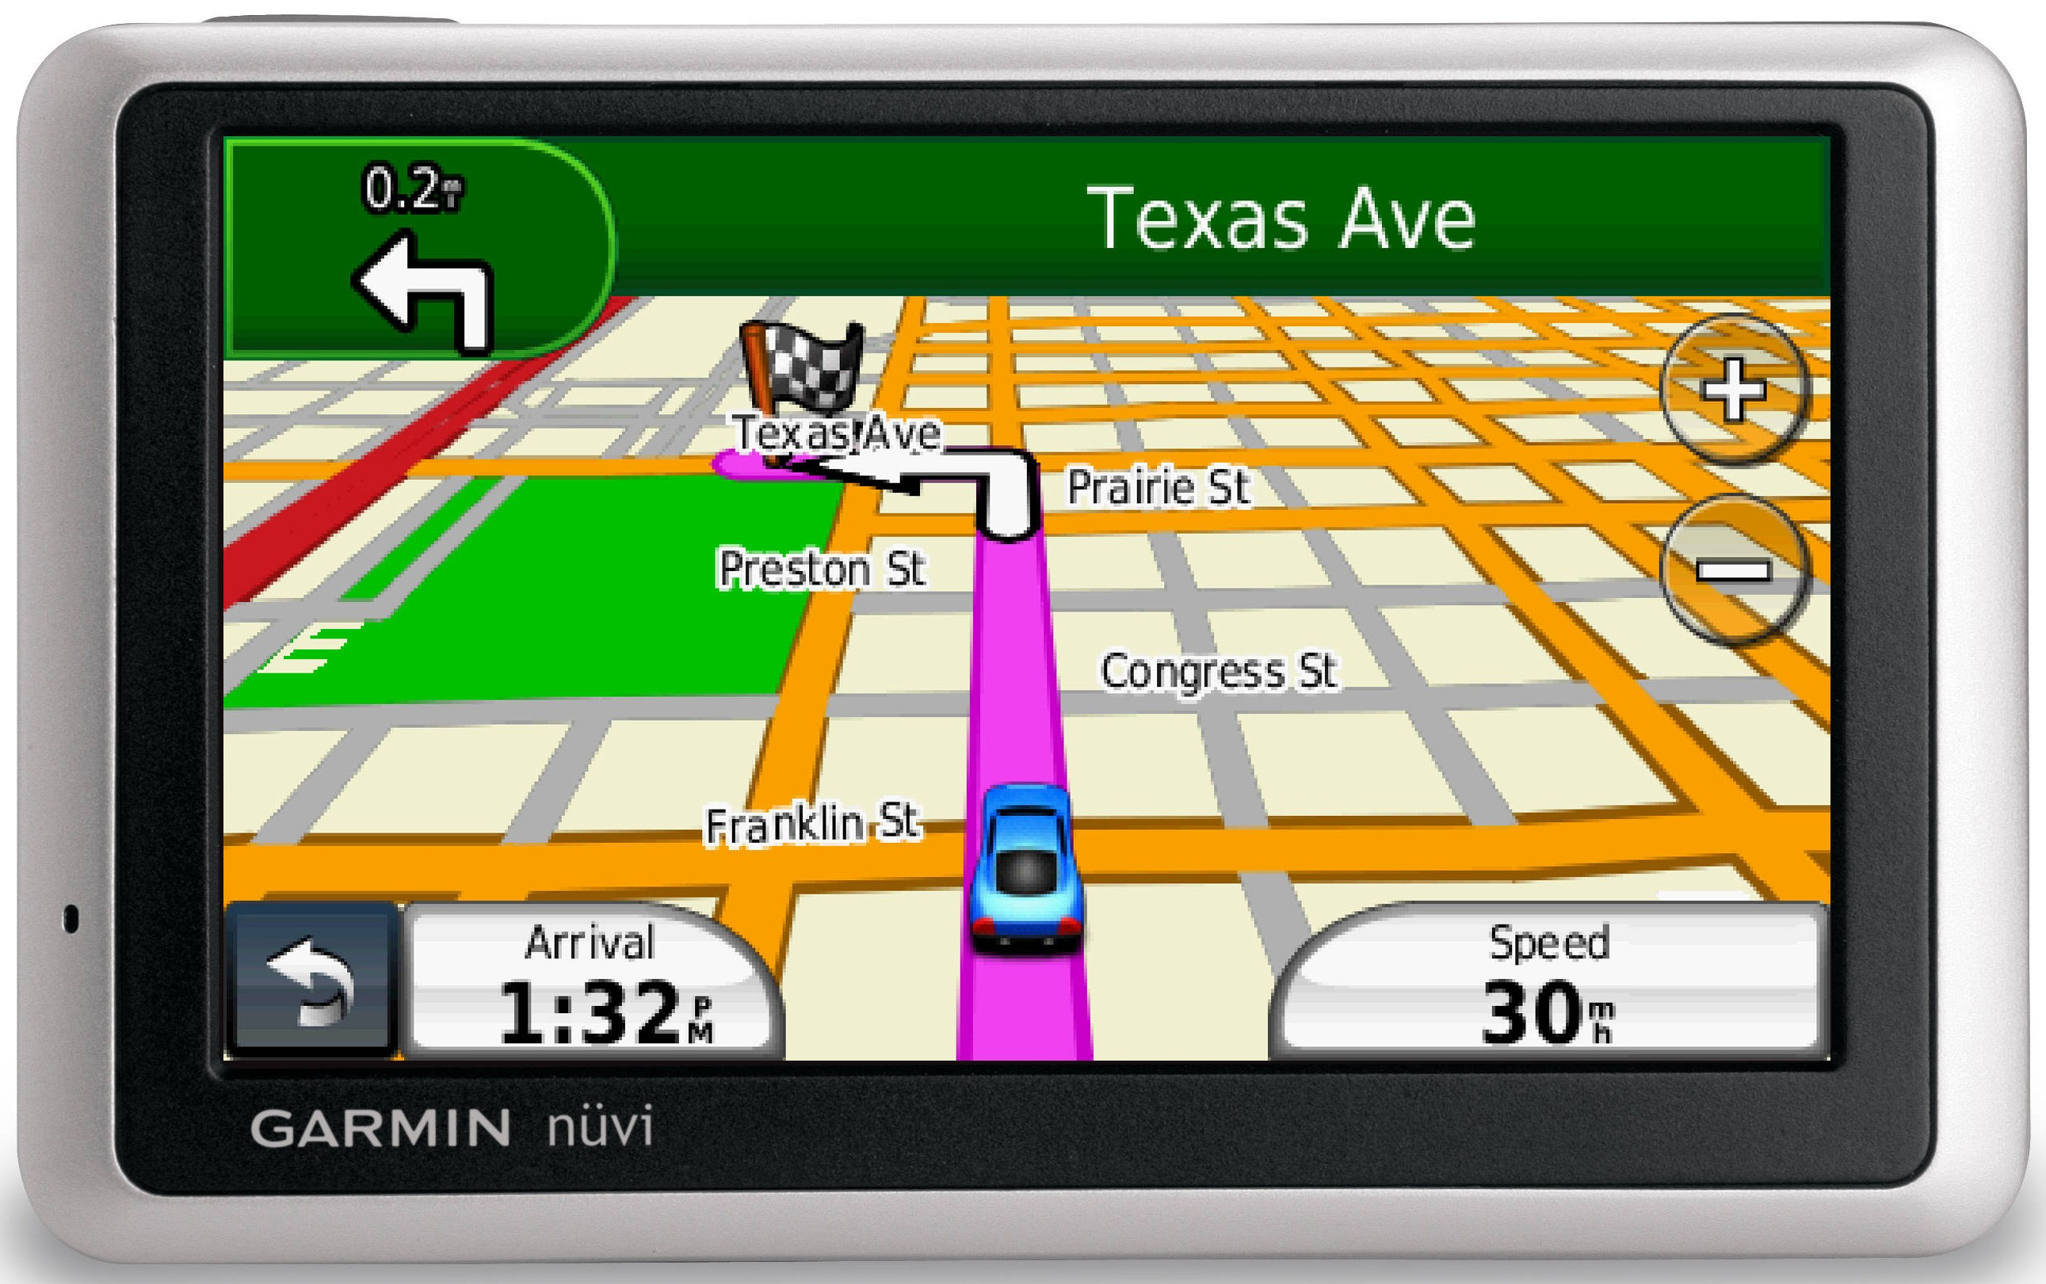
Simulation of Autonomous Vehicles
Using GPS Transceivers
By: Amndeep Singh Mann
Syslab – Gabor – Pd. 4 – 12/13/2012

Slide 2
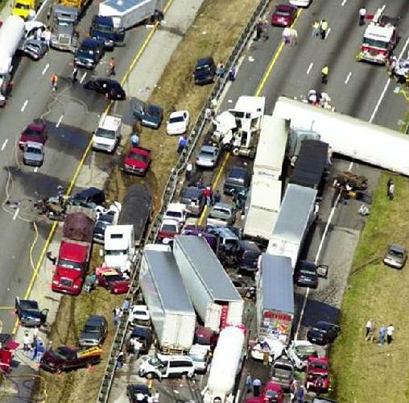
Premise
Vehicle accidents accounted for 33,808 deaths in 2009 for the United States alone
Autonomous vehicles get rid of the “human element”
Google has made many advancements in this field
Notes:
1) May remember the car crash and screaming sounds coming from where Mr. Steuben was teaching last class
2) Machine is always aware, can process more information faster, and can react basically instantly
3) Its autonomous cars have driven over 300,000 miles, with only two accidents (both of which were not the fault of the autonomous driver {one time it got rear-ended at a stoplight, the other time was when it was being driven manually})

Slide 3

Premise cont.
Northern Virginia is a high traffic area
Everyone wants to get where they want to go quickly
What would happen if GPS devices were transceivers instead of receivers?
Notes:
1) LA, NYC, DC
2) Leading to the numerous cases of road rage and otherwise bad, usually aggressive, driving
2) Also often use GPS receivers, newer models of which also have traffic avoidance capabilities
Unfortunately, usually not that good, and only works on a few major roads or highways (if then)

Slide 4
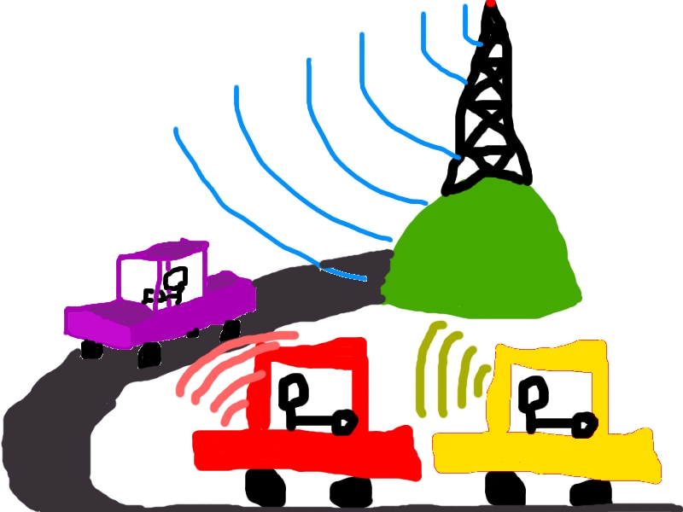

Idea
If they were transceivers, maybe we could share local traffic conditions
!!?!??!? ‽
Profit
Notes:
GPS traffic capabilities would be more accurate
Traffic is less dense due to increased use of side-roads
Get where you want to go faster and more safely

Slide 5
Problems
Not rich
Not experienced with hardware at this level
X
Notes:
1) Not supported by a venture capitalist group → don't have the money to just buy the services of an engineer
2) Obvious

Slide 6
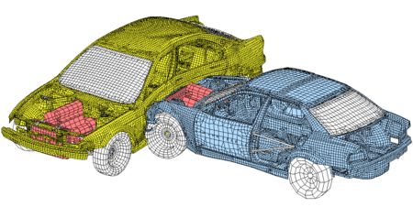
Results
Make a simulation

Slide 7

Problems cont.
Computationally intense
Has to be “graphical” and “web-based”

Slide 8
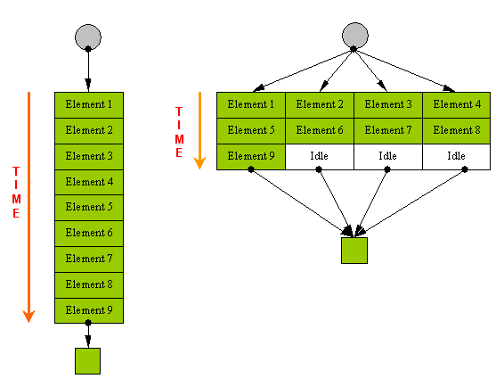
Results cont.
Java Applet
Servlet
Parallel Paradigm
Notes:
1) In browser, GUI with interactivity
2) Capable of using better hardware
3) Para – dime
3) Separate threads use more cores, make the simulation faster

Slide 9
Goals
A website with user interactivity
A server capable of taking that user information and running a simulation
Map-builder
Simulation
  Dumb vehicles
  Vehicles using route-finder
  Vehicles using the transceiver
  User driven vehicle

